Slide 1

1st National Conference on Sustainable Civil Engineering & Geospatial Technologies: Materials & Innovations for Climate Resilience (NCRT-SCE 2026) Buddha Institute of Technology GIDA, Gorakhpur Date of Conference: 15th – 16th April 2026
Fabrication of Grey Water Filter
(JALRAKSHAK BIOPURE)
Under the Guidance
Mr. Pratish Kannaujiya
Assistant Professor
Presented by – Sarvesh Singh
Roll no. - 2305250009012
Civil engineering 4th year
Department Of Civil Engineering, BIT Gorakhpur

Slide 2
Contents
Introduction
Problem Statement
Objectives
Literature Survey
Proposed Solution / Methodology
Results & Analysis
Conclusion & Future Work
Acknowledgements
References

Slide 3
Introduction
Water is essential for life and ecosystems.
Greywater reuse reduces strain on freshwater resources.
Greywater: 75%-90% of household wastewater.
Sources: Bathing, kitchen, laundry.
Greywater accounts for up to 75% of the wastewater volume produced by households, and this can increase to about 90% if dry toilets are used. It has also been estimated that greywater produced accounts for about 69% of domestic water consumption.

Slide 4
Problem Statement
India faces severe water scarcity, especially in semi-arid and urban regions.
Rainwater harvesting alone is insufficient due to irregular rainfall distribution.
Greywater contributes about 70–75% of total household wastewater.
Untreated greywater increases sewage treatment loads and pollutes local water bodies.

Slide 5
Objectives
To minimize fresh water usage by reusing treated greywater.
Treat greywater for safe non-potable purposes like toilet flushing, gardening, vehicle washing.
Conduct physical, chemical, and biological characterization of greywater.
Design, fabricate, and test a cost-effective greywater filtration system.

Slide 6
Literature Survey
1.Piyush Gupta (2016) performed "Design and Performance Evaluation of a Greywater Treatment System for Residential Complexes in India".
2.Himanshu Joshi (2017) performed the Evaluation of Low-Cost Greywater Treatment Systems for Urban Areas in India. This research article evaluates the performance of low-cost greywater treatment systems suitable for urban areas in India.
3.Shashwat G. Mishra (2018) did the task on Assessment of Greywater Treatment Technologies for Urban India. This study assesses different greywater treatment technologies for urban India.
4.Keshav Mohan(2021) performed Greywater Recycling for Domestic Use in India. This review article explores the opportunities, challenges, and perspectives of greywater recycling for domestic use in India.

Slide 7
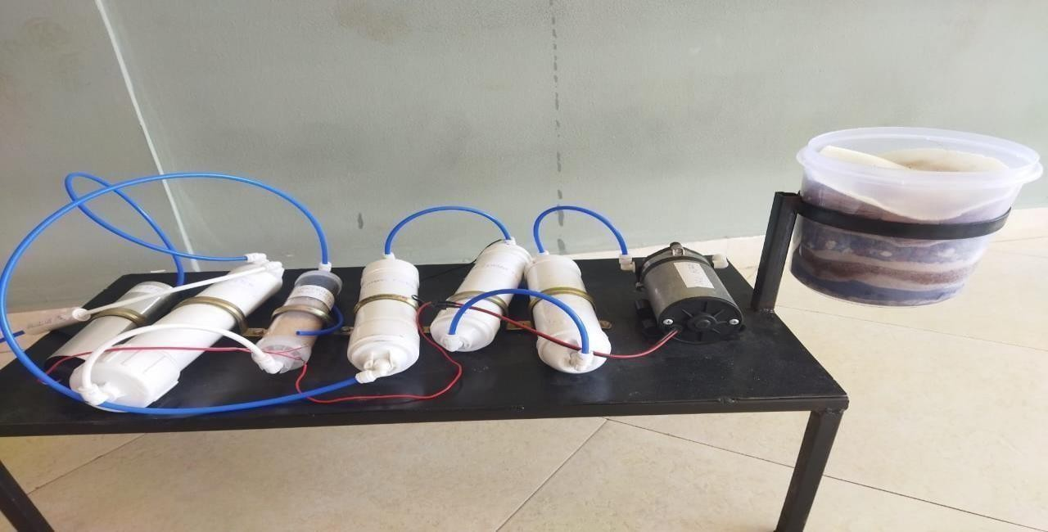
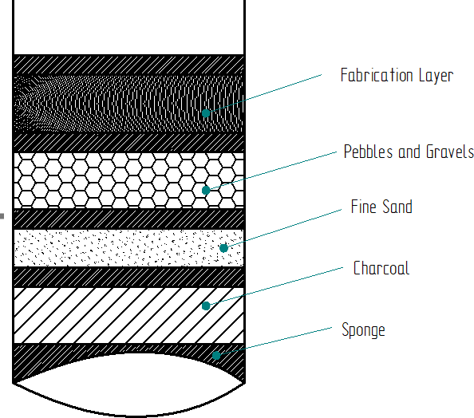
Proposed Solution
Biofilter: Fine Sand, Gravels & Pebbles, Charcoal, Coconut Husk.
Post-cleaning: Sediment filter, Carbon filters, Mineral cartridge.
Other: Booster pump, RO filter, UV filter, Hose pipes, pH meter.
Activated Carbon: Removes odour, colour, and residual chemicals.
UV Filter: Eliminates microorganisms ensuring safe reuse.
Mineral Cartridge: Improves taste and adds essential minerals.

Slide 8
Methodology
Collect greywater sample.
Prepare Biofilter with multiple layers.
Pass water through booster pump and filters (sediment, carbon, mineral).
Final treatment with RO and UV filters.
Test pH before and after treatment.
Biofilter acts as first stage removing large particles and improving clarity.
Sequential flow through filters ensures progressive water quality improvement.
Grey water
Bio filter
Filtered Water
Booster Pump
Sedimentation Filter
Carbon Filter
Mineral Cartridge Filter
RO Filter
UV Filter
Purified Water

Slide 9
Results & Analysis
The filtration system significantly improved the overall quality of greywater
Turbidity reduced from 5.8 NTU to 6.5 NTU, making the water visibly clearer.
TDS decreased from 950 mg/L to 480 mg/L, indicating reduced dissolved impurities.
pH stabilized from 6.83 to 7.05, reaching a neutral and safe range.
BOD dropped from 120 mg/L to 25 mg/L, showing lower organic pollution.
COD reduced from 280 mg/L to 65 mg/L, confirming effective removal of contaminants.
The treated water became clear, odorless, and safe for non-potable uses.
Suitable for gardening, toilet flushing, and general cleaning.
Overall, the system proved efficient, reliable, and effective for greywater treatment.

Slide 10
pH improved closer to neutral after complete filtration.
Graphical representation shows improvement in ph.
Sl. No | Sample | pH values
1 | Grey Water sample | 6.83
2 | Fine Sand sample | 5.9
3 | Charcoal sample | 6.97
4 | Gravel sample | 6.94
5 | Pre sample | 6.6
pH Test for different water
8
7
6
5
4
3
2
1
grey
fine
gravel
Water
charco
pre
p
Schematic Graphical representation of different pH values

Slide 11
Sr. No. | Parameter | Unit | Before Filtration (Sample A) | After Filtration (Sample B) | Permissible Limit (for Non-potable Use)*
1 | pH | – | 6.83 | 7.05 | 6.5 – 8.5
2 | Turbidity | NTU | 58 | 6.5 | <10
3 | TDS (Total Dissolved Solids) | mg/L | 950 | 480 | <2000
4 | BOD (Biochemical Oxygen Demand) | mg/L | 120 | 25 | <30
5 | COD (Chemical Oxygen Demand) | mg/L | 280 | 65 | <100
6 | DO (Dissolved Oxygen) | mg/L | 2.1 | 6.4 | >4
7 | Hardness (as CaCO₃) | mg/L | 410 | 190 | <500
8 | Odour | – | Unpleasant | Odourless | –
9 | Colour | – | Greyish | Clear | –
Test of water samples before and after Filtration

Slide 12
Application
1.Residential: Toilet flushing, irrigation.
2.Commercial: Offices, hotels, schools.
3.Industrial: Process water reuse.
4.Agricultural: Irrigation for crops.
5,Water-scarce regions: Alternative source.
6.Greywater reuse is ideal for regions facing frequent droughts.
7.Helps in reducing municipal water supply load by up to 50%.

Slide 13
Advantage and disadvantage
Advantages:
Reduces strain on freshwater resources by reusing treated greywater for non- potable purposes.
Helps to conserve water and reduce water bills.
Promotes sustainable water management practices.
Can reduce the discharge of pollutants into waterways.
Can be used in both residential and commercial purposes.
Can be used in water-scarce regions to reduce dependence on freshwater sources.
Disadvantages:
Requires initial investment for installation and maintenance of greywater purification system.
Requires regular maintenance and monitoring to ensure safe and effective water reuse.
Treated greywater may not be suitable for all non-potable uses (e.g., not suitable for drinking or cooking).
The level of treatment required may vary depending on the intended reuse of the water.

Slide 14
Conclusion & Future Work
Greywater treatment is a cost-effective and eco-friendly method of water conservation.
It reduces fresh water demand by reusing up to 70% of household wastewater.
Final treated water is suitable for non-potable uses such as flushing, irrigation, and cleaning.
Promotes sustainable water management at household and community levels.
Future improvements in greywater treatment systems.
Enhance filtration efficiency with advanced materials.
Develop compact, modular, and portable designs.
Use IoT-based monitoring for water quality testing.
Recover useful resources like nutrients during treatment.
Government policies and awareness campaigns for adoption.

Slide 15
Acknowledgements
I would like to express my sincere gratitude to my project guide Mr. Pratish Kannojiya for his valuable guidance, support, and encouragement throughout the project.
I am highly thankful to our Head of Department Mr. Baijnath Nishad for providing the necessary facilities and academic support.
I extend my heartfelt thanks to the Research Head Mr. Ankur Kumar for his guidance and valuable suggestions.
I would also like to thank my institution for providing an excellent environment to complete this project.
Finally, I am grateful to everyone who directly or indirectly contributed to the successful completion of this work.

Slide 16
References
1. "Design and Performance Evaluation of a Greywater Treatment System for Residential Complexes in India" by Piyush Gupta et al. (2016)
2. "Greywater Recycling for Domestic Use in India: Opportunities, Challenges, and
Perspectives" by Keshav Mohan et al. (2021)
3. "Assessment of Greywater Treatment Technologies for Urban India" by Shashwat G. Mishra et al. (2018)
4. "Design and Development of a Low-Cost Greywater Treatment System for Indian
Households" by Neha Gupta et al. (2019)
5. "Evaluation of Low-Cost Greywater Treatment Systems for Urban Areas in India" by Himanshu Joshi et al. (2017)

Slide 17
Thank You

